Slide 1



Enhancement of Question Answering System Accuracy via Transfer Learning and BERT

Slide 2

Presented by
Jannatus Sakira Khondaker
Id - 20301468
Team - 10
RA - SANIA AZHMEE BHUIYAN
ST - MEHNAZ ARA FAZAL

Slide 3
About this
Presentation
This paper proposes a framework called BAT-KBQA, which uses transfer learning and BERT to improve the accuracy of Chinese knowledge base question answering.
The paper evaluates the framework on a large-scale Chinese knowledge base and shows that it outperforms several baselines and achieves state-of-the-art results.

Slide 4


Table Of Contents
Summary
Limitations
Synthesis

Slide 5


Summary

Slide 6

Hypothesis
The paper aims to address some of the challenges and limitations of existing methods for Chinese knowledge base question answering, such as the complexity and ambiguity of Chinese entity
linking, the lack of association between entities
and predicates, and the difficulty of generalizing
to different domains and knowledge bases.

Slide 7
Contribution
It proposes a transfer learning approach that leverages a character segmentation task to enhance the performance of named entity recognition, which is crucial for entity linking.
It designs a BERT-CNN model for entity disambiguation that incorporates the predicate features of the candidate entities, which can help to resolve the ambiguity and diversity of natural language questions.
It develops a BERT-Softmax model for predicate matching that also uses the predicate features of the answer entities, which can increase the relevance and accuracy of the answer selection.
It conducts extensive experiments on a large-scale Chinese knowledge base and demonstrates the effectiveness and superiority of the proposed framework over several baselines and existing methods.

Slide 8

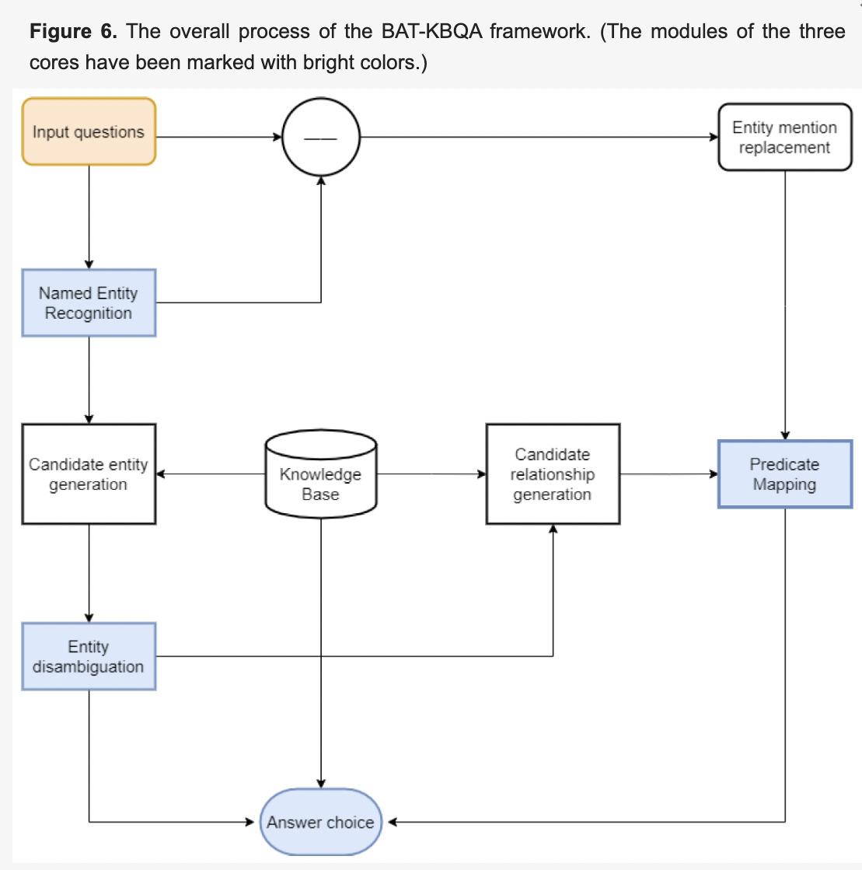
Methodology
The paper adopts a data-driven and deep learning-based approach to build the BAT-KBQA framework. It uses a pre-trained BERT model as the backbone of the framework and fine-tunes it on different subtasks of
Chinese knowledge base question answering.

Slide 9
Conclusion
The paper concludes that the proposed BAT-KBQA framework can effectively improve the accuracy of Chinese knowledge base question answering by using transfer learning and BERT.

Slide 10
Limitations
1st
2nd
3rd
It relies on a large amount of annotated data for fine-tuning the BERT model, which may not be available for some domains or knowledge bases.
It does not consider the semantic similarity or diversity of the candidate entities and predicates, which may affect the ranking and scoring of the answer selection.
It does not handle some challenging scenarios, such as questions with multiple entities, predicates, or answers, or questions that require reasoning or inference over the knowledge base..

Slide 11
Synthesis
The paper presents a novel and effective framework for Chinese knowledge base question answering, which can be useful for various applications, such as intelligent assistants, information retrieval, and knowledge discovery.
The system may fill the gap in the technical research of the tutor selection service system. In future work, different subtasks can be trained in combination, or more knowledge graph representation learning methods can be introduced to obtain richer features.

Slide 12
Thank you!

